Slide 1



Personal Preference Program (PPP)- Transition Training 2025
Notes:
Welcome to Palco!
I’m thrilled to have you all here for our very first Personal Preference Transition Webinar. This marks an exciting step forward, and I’m so glad you’re joining us as we begin this journey together.
My name is Pamela Jones, and I’m the Learning & Development Manager here at Palco. I’m joined today by a few of my wonderful colleagues who will help guide us through the session.
Before we get started, just a few housekeeping notes:
You will be muted throughout the presentation to minimize background noise.
Please use the Q&A feature to submit any questions you may have—we’ll be monitoring it and will address your questions during the session.
We’ve attached a few important documents for your reference, including:
The Payroll Schedule
A Who to Contact List
We’re excited to share this information with you and look forward to a productive and engaging session!

Slide 2

 Welcome to Palco
 Transition Enrollment Overview
 EVV & Time Entry
 Electronic timesheet review and submission process
 Palco Website / Resources
 Customer Support
TODAY’S TOPICS
2

Slide 3

COMPANY OVERVIEW

Slide 4



MISSION & CORE VALUES
Empowering Independence. Sharpened by experience and amplified by
modern technology, Palco advocates for people to live independent lives.
PALCO
4

Slide 5




₁st
COMPANY HIGHLIGHTS
over
100%
25
Nationally-recognized
VF/EA in the
thought leaders in self-
Certified Public Accountant
years of FMS experience
country
(CPA) and privately owned
direction
18
Programs Served
13
years
$580M
Women owned and operated
of Support Broker Experience
In total payroll and vendor payments administered
5

Slide 6
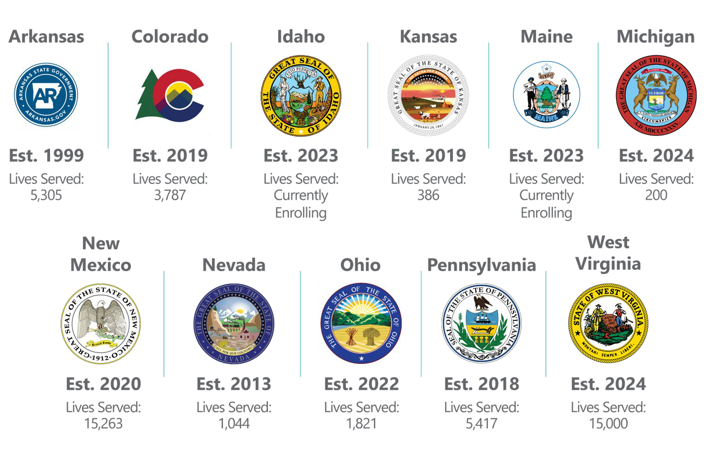

Slide 7

Palco, Inc. is excited to be the new payroll company for the Horizon NJ Health Members enrolled in the Personal Preference Program starting in 2025.
2024 PALCO 7

Slide 8


TRANSITION DETAILS

Slide 9


KEY DATES
Date | Activity | Important Notes
12/01 | 1st pay period with Palco begins
12/01 | Timesheets due to PPL for November dates of service. | Last PPL pay day is 12/10.
12/15 | First timesheets due to Palco | Palco will process all timesheets going forward.
12/24 | First pay day with Palco | For dates of service 12/01-12/14.
12/15 | Last day to submit late timesheets to PPL. | PPL will not process any timesheets after 12/15 so be sure you have submitted everything.
Notes:
Palco follows same schedule
11/17-11/30 Timesheets 12/1 will end PPL
Begin with Palco 12/1- will only payout for 2 days in your worker worked
Payroll schedule is posted on the Palco website and the schedule is the same as PPL.
12/15 – please note last day to submit time up to 10/31
11/3 10:00 am
11/5 3:00 pm
11/7 12:00 pm
11/10 10:00 am
11/12 10:00 am
11/18 2:00 pm
11/20 10:00 am
11/24 4:00 pm
11/26 11:00 am

Slide 10


KEY TASKS TO COMPLETE!
TRANSITION CHECKLIST
Task #1:
Attend one of our training sessions to get help with the switch to Palco. We want to make this change easy for you, and this training will teach you everything you need to know!
Task #2:
Participants, Authorized Representatives, and Workers
need to complete an online transition enrollment with Palco. Enrolling online is the fastest and easiest way to complete your enrollment with Palco! Check your email for a communication from Palco with instructions.
Task #3:
Prepare to use EVV with Palco and know the key dates
for when you will stop using PPL’s system and start using Palco!
Task #4:
Make sure all your time is submitted to PPL timely for
payment before the switch to Palco.
2023
20
Notes:
What does this look- Welcome letter
Read the bullets= Palco will assist
Moving forward once you are enrolled with Palco your Horizon support counselor will be in contact for future support.
Horizon support counselor will take over the role of financial consultant assisting you with cash management plan and quarterly visits
EVV- which will discuss in a few slides
Read : What’s next
Pull over the website
Call out training & resources
If you need assistance contact customer support
Read – what’s next
11/3 10:00 am
11/5 3:00 pm
11/7 12:00 pm
11/10 10:00 am
11/12 10:00 am
11/18 2:00 pm
11/20 10:00 am
11/24 4:00 pm
11/26 11:00 am

Slide 11

Participant Enrollment Packet
Notes:
What does this look- Welcome letter
Read the bullets= Palco will assist
Moving forward once you are enrolled with Palco your Horizon support counselor will be in contact for future support.
Horizon support counselor will take over the role of financial consultant assisting you with cash management plan and quarterly visits
EVV- which will discuss in a few slides
Read : What’s next
Pull over the website
Call out training & resources
If you need assistance contact customer support
Read – what’s next

Slide 12

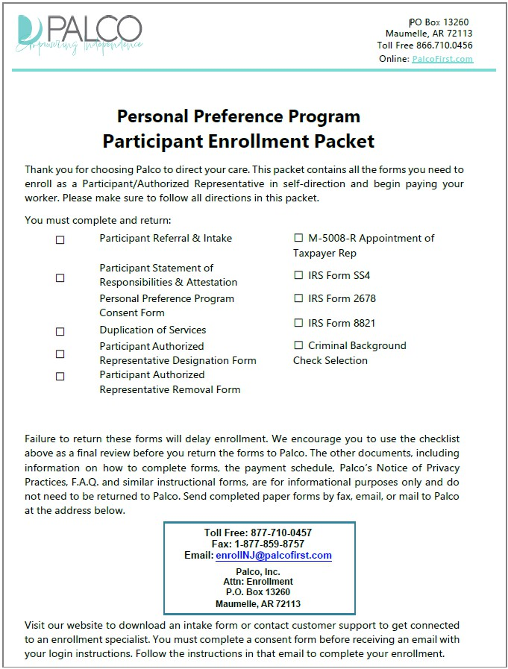

Participant Enrollment Packet
Notes:
All of these forms are standard- from former FI

Slide 13
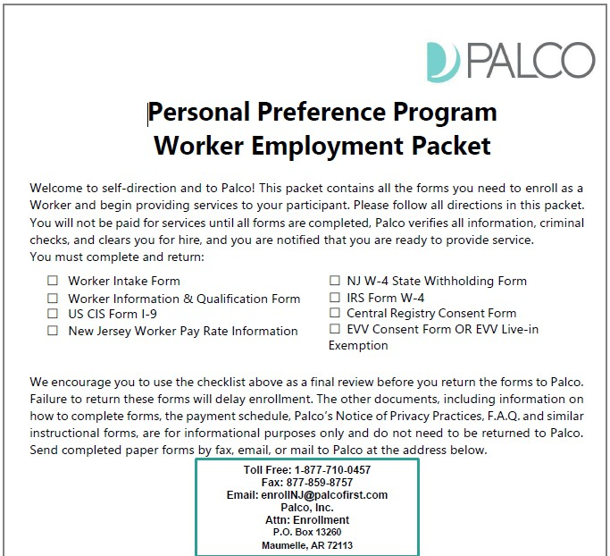
Worker Employment Packet
Notes:
Same forms from former FI

Slide 14

ELECTRONIC VISIT VERIFICATION (EVV)
Notes:
After you have transitioned and receive a good to go, start date you will begin clocking in and out
EVV is not new but this is how we should

Slide 15


WHAT IS EVV?
Electronic Visit Verification (EVV) is a validation of the date, time, location, type of Personal Care or Home Health Care Services being provided, and the individuals providing and receiving services. This information helps to ensure that the Participants receive the expected care. EVV is a federal mandate included in section 12006 of the 21st Century Cures Act.
Palco has created a web-based, user-friendly platform to provide our Participants with tools to remain EVV compliant. The two options for using EVV with Palco are:
Connect
Telephony / IVR (Interactive Voice Recognition) via a touchtone phone.
Electronic Visit Verification (EVV) is a Federal Mandate! Compliance is required.
15

Slide 16
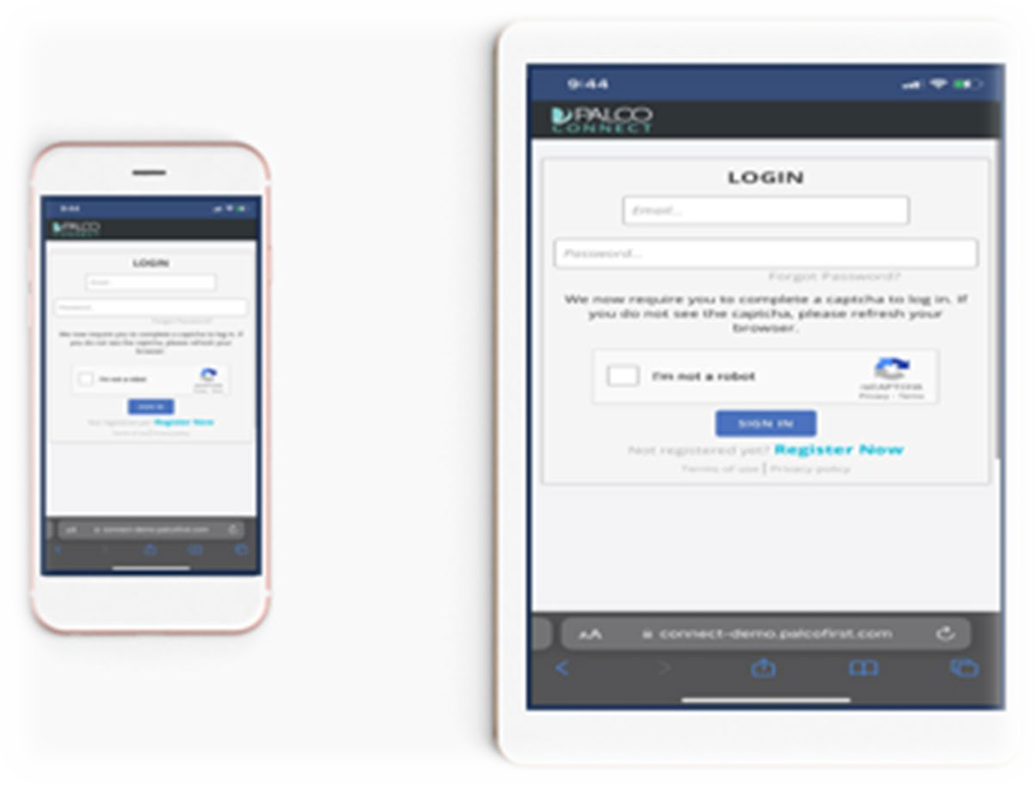

GETTING STARTED
TO SUBMIT TIME TO PALCO, YOU WILL NEED A MOBILE DEVICE THAT CAN CONNECT TO THE INTERNET, SUCH AS A PHONE OR TABLET. YOU CAN ALSO INSTALL THE APPLICATION ON YOUR LAPTOP OR DESKTOP COMPUTER USING A WEB BROWSER. FOLLOW THESE STEPS TO ACCESS PALCO’S EVV APPLICATION.
Step 1. Open the browser on your internet-connected device
You can use a phone or tablet. Depending on your device, your browser may be called Safari, Chrome, or simply Internet.
Step 2. Go to connect.palcofirst.com Step 3. Sign in to Connect
If you do not already have a Connect account, you will need to create one. Use the Register Now button to create an account. Come back to this step once that is done.

Slide 17
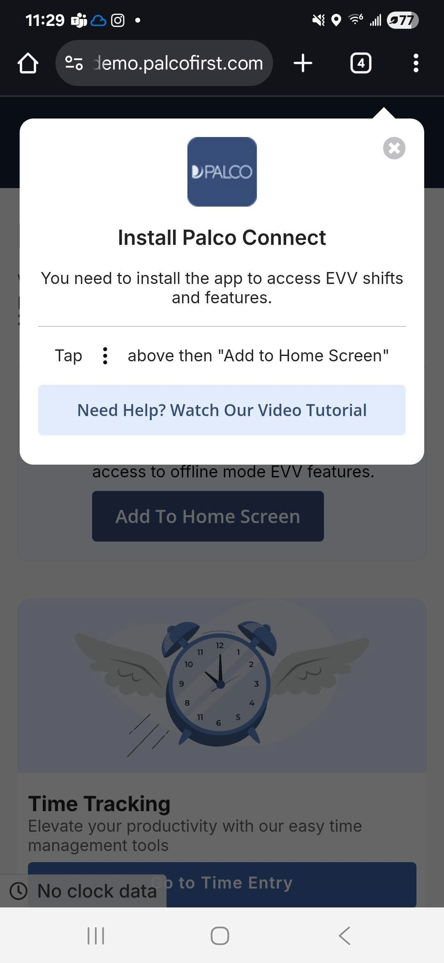
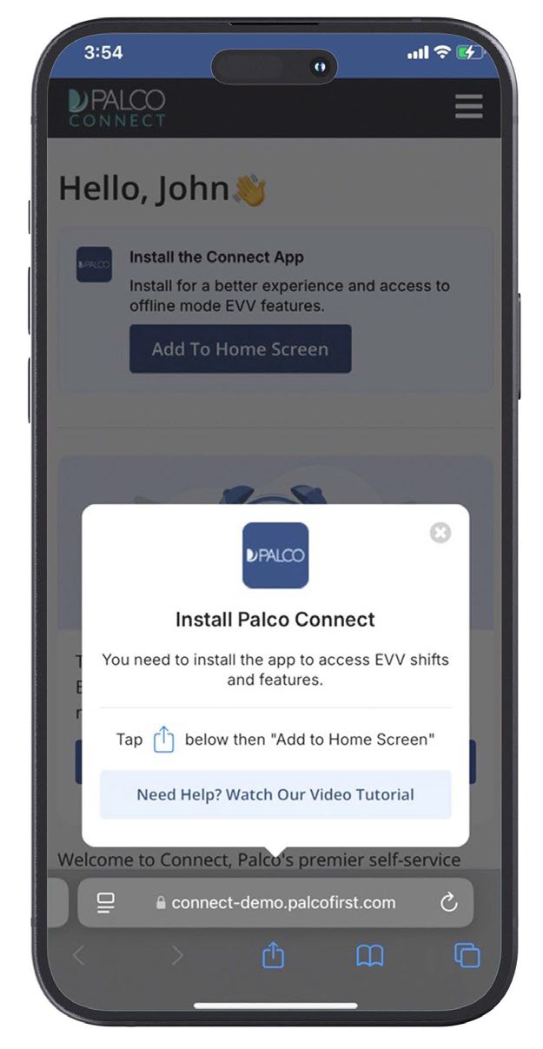

GETTING STARTED CONTINUED
Step 4. Click the blue “Add to Home Screen” button
On the Connect home screen, click the blue button that says “Add to Home Screen”.
Step 5. Tap the Android .
icon for iPhone or the icon for
Following the on-screen instructions, tap the icon. Then, tap “Add to Home Screen” within the on-screen menu.

Slide 18
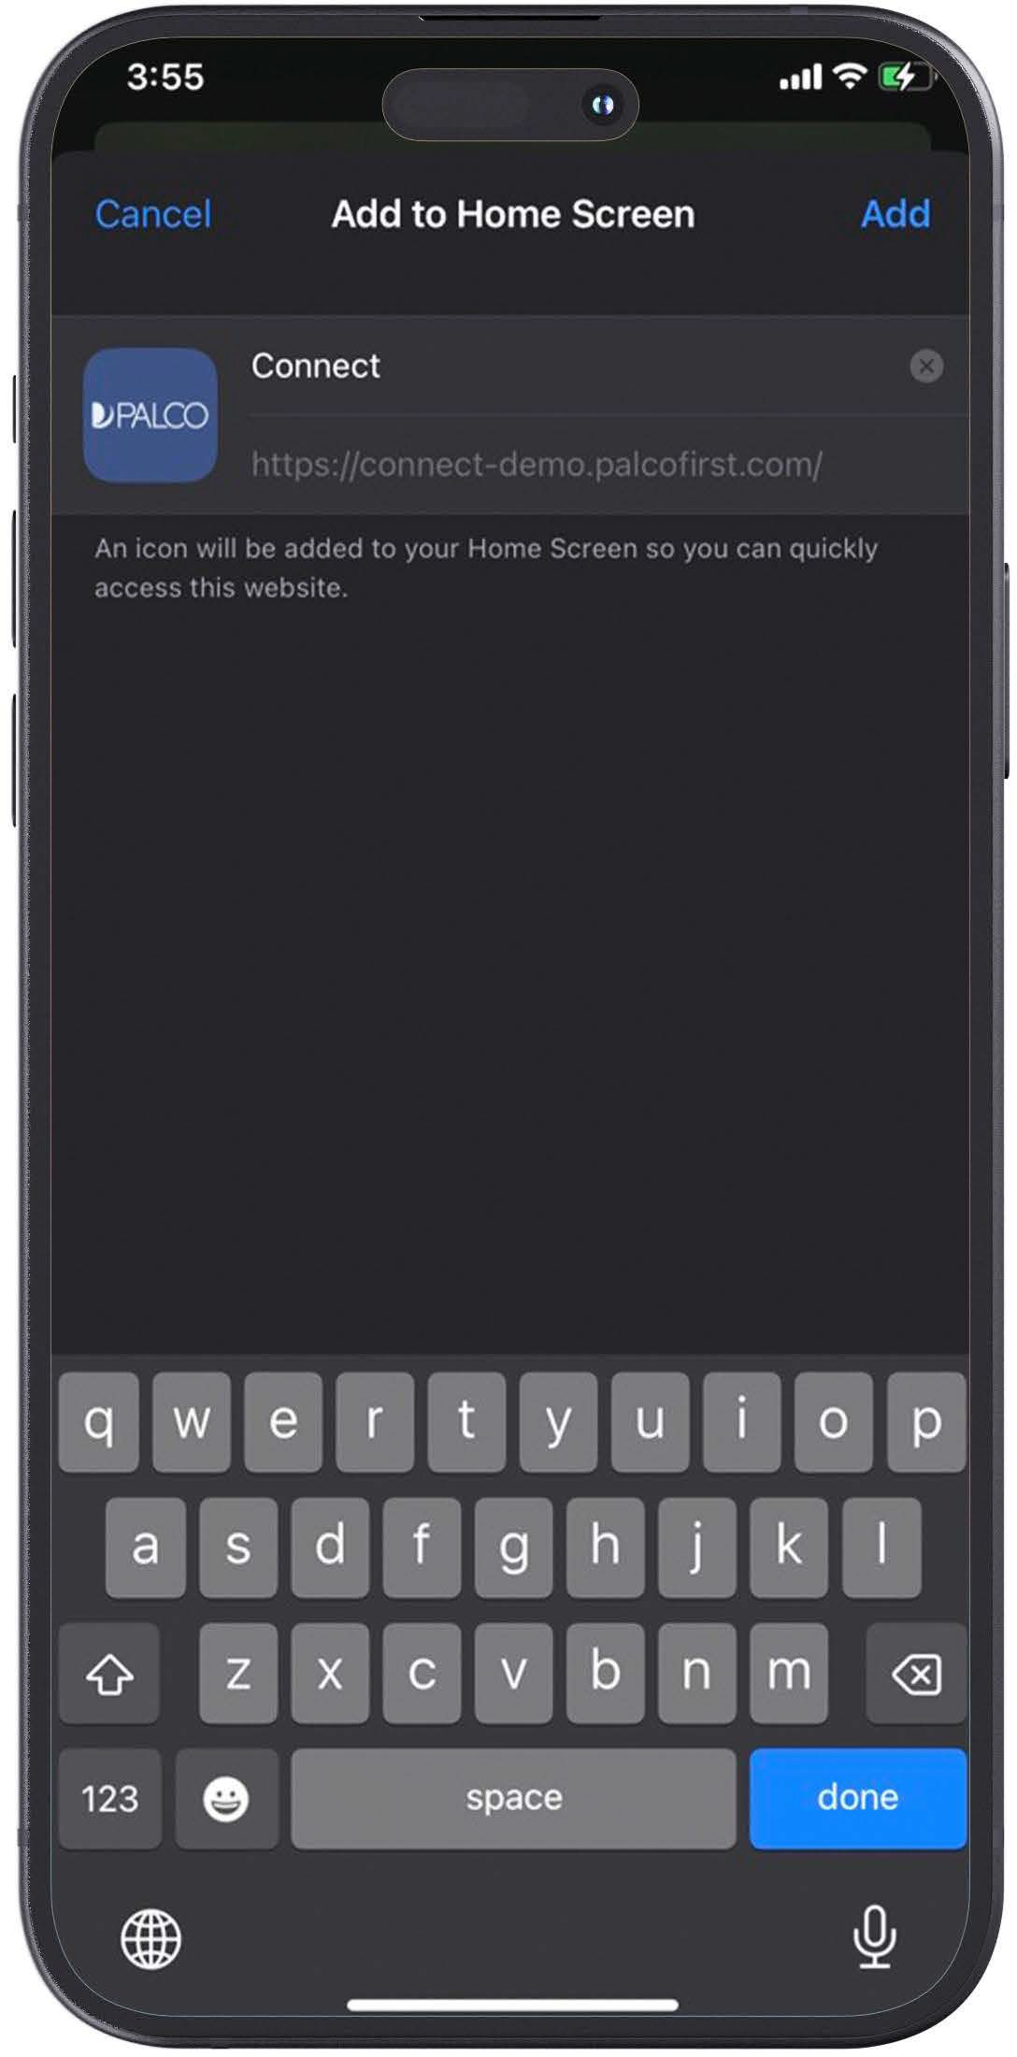
GETTING STARTED CONTINUED
Step 6. Review and Confirm
By default, the Palco application shortcut will be added to your device with the name Connect. You can choose to change this name, or leave it as is. Then, click Add.

Slide 19
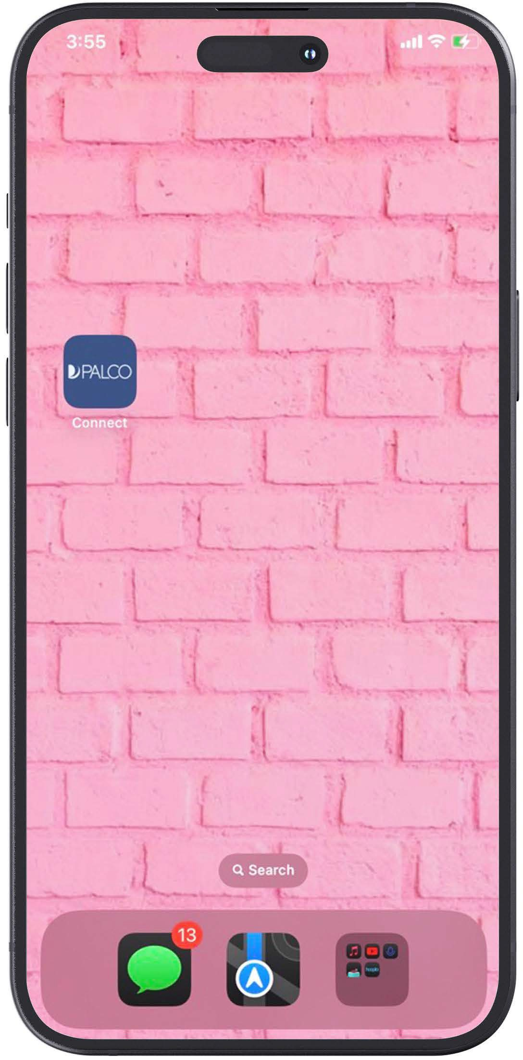
GETTING STARTED CONTINUED
Step 7. Begin using the Application
Go to the home screen of your device. Then, tap the new Palco EVV app icon to start using it.
Note: When you open the app for the first time, you may be asked to log in to Connect again.

Slide 20
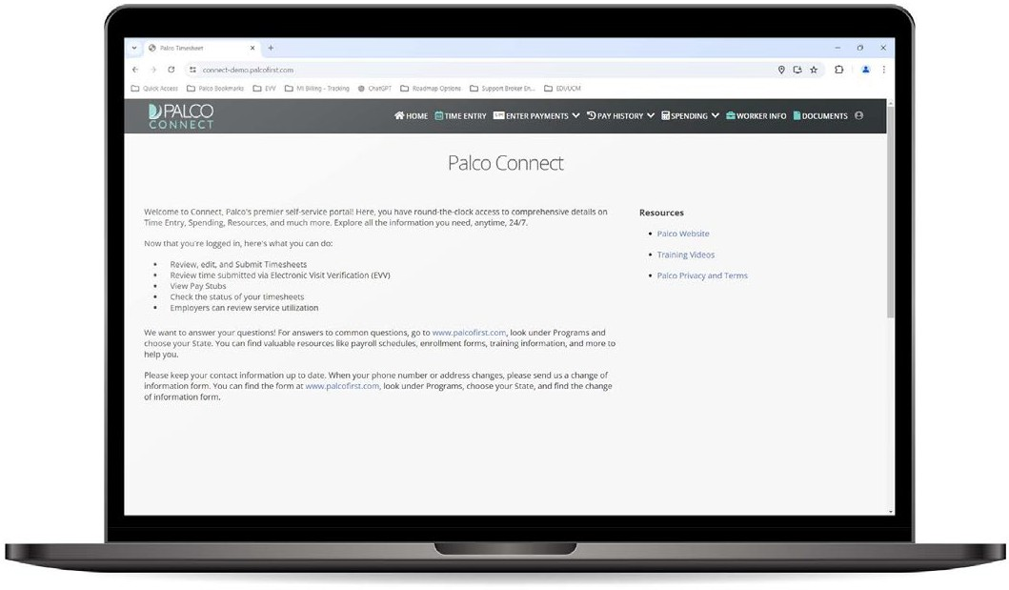
GETTING STARTED
FOLLOW THESE STEPS TO INSTALL PALCO’S EVV APPLICATION ON A LAPTOP OR DESKTOP COMPUTER USING A WEB BROWSER
Step 1. Open the browser on your internet-connected device
You can use a laptop or desktop.
Step 2. Go to connect.palcofirst.com Step 3. Sign in to Connect
If you do not already have a Connect account, you will need to create one. Use the
Register Now button to create an account. Come back to this step once that is done.

Slide 21
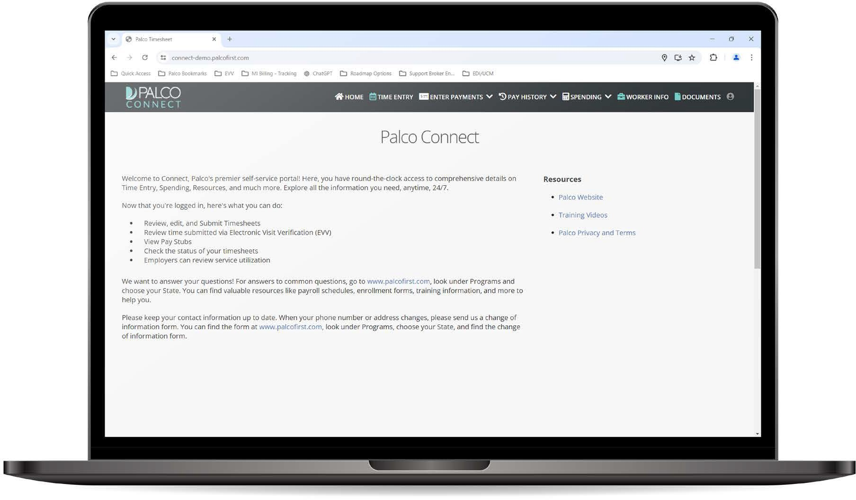
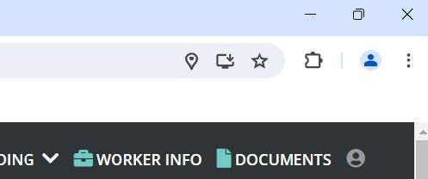
GETTING STARTED CONTINUED
Step 4. Click the Install Icon
On the right side of the address bar will be an icon. Hovering over it says “Install Palco Connect.”
Click this icon to continue.

Slide 22
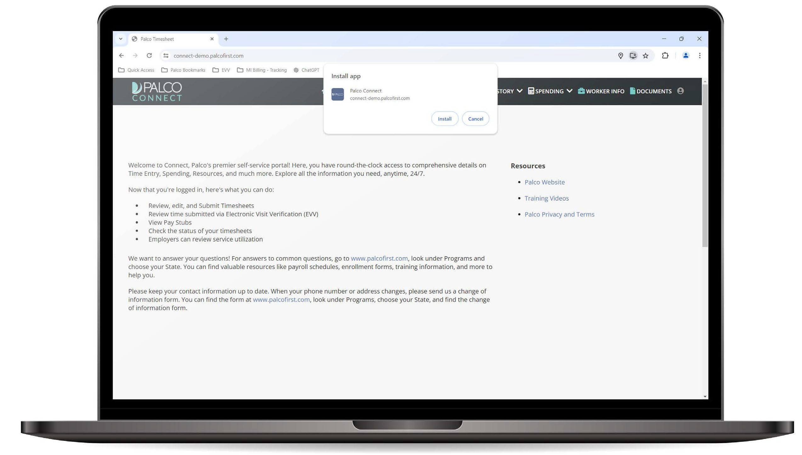
GETTING STARTED CONTINUED
Step 5. Select “Install” in the pop-up window.
Note: Depending on the web browser you are using, your screen may look slightly different than what is shown.

Slide 23

PARTICIPANT WORKSITE LOCATIONS

Slide 24
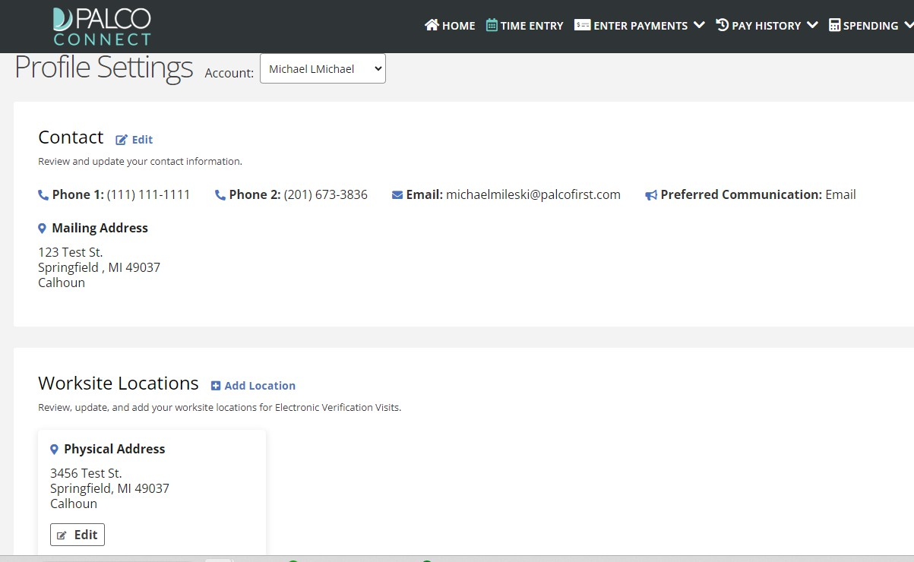
PARTICIPANT WORKSITE LOCATIONS
One of the most important parts of EVV is location reporting. The participant needs to add worksite locations to their profile.
Step 1
Go to the Profile Settings Page and Click Add Location
It is in the Worksite Locations section, which is below the Contact section.

Slide 25
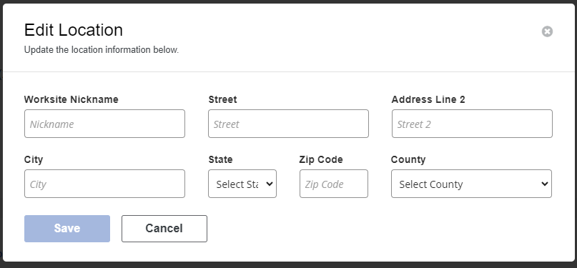
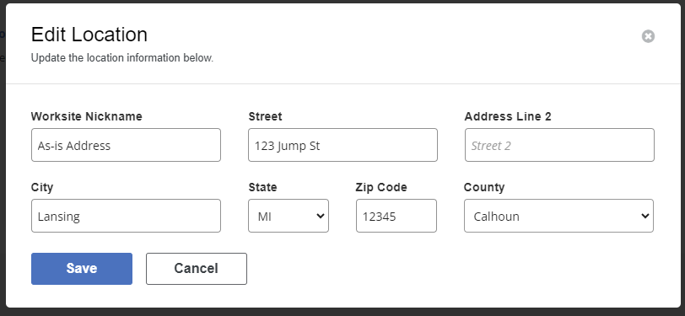
PARTICIPANT WORKSITE LOCATIONS
Step 2.
Input the Location Information
When typing the street address, several options may appear. If you see the correct one, you can click it, and the remaining fields will autofill.
Step 3.
Verify Information is Correct Then Click Save
The system will make sure the address is valid. If it is not recognized, you will be alerted.
Notes:
We recommend you use the suggested address when it autofill's- always
Use my address as an example

Slide 26
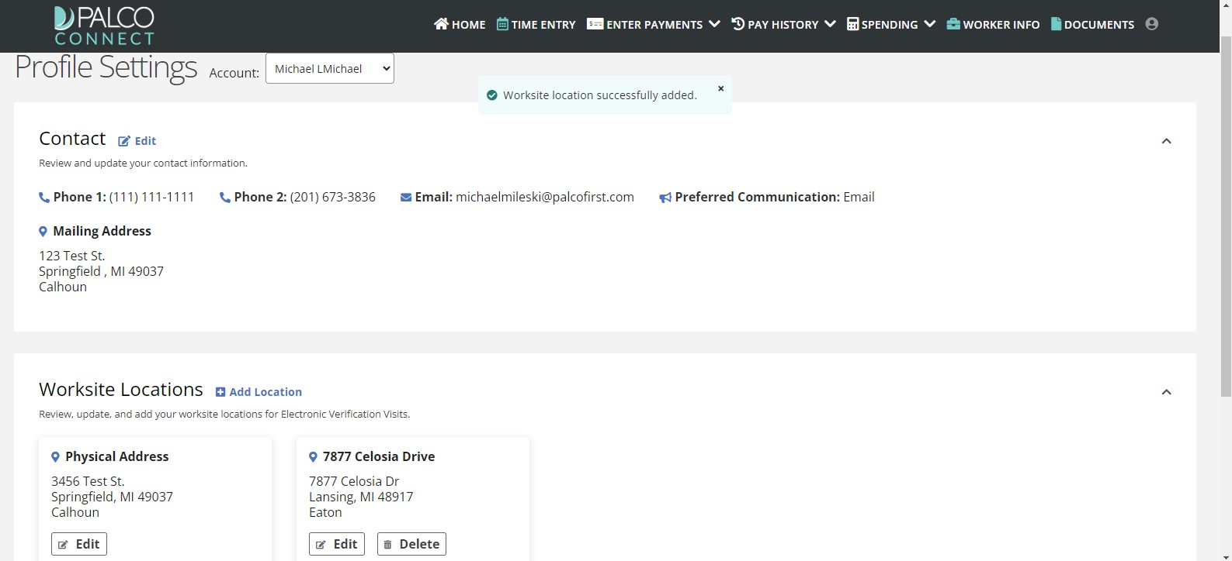
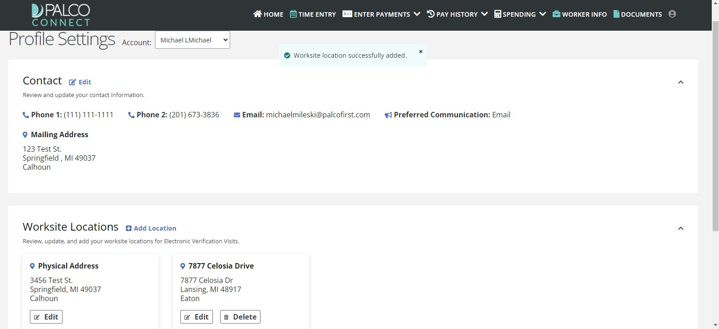
PARTICIPANT WORKSITE LOCATIONS
Step 4.
Make Sure the New Location Appears
If the save was successful, you will see “Worksite location successfully added” pop up. You will also see the address under Worksite Locations.
Step 5.
To Make Changes to Existing Locations, Use Edit and Delete
It’s easy to make changes to a saved worksite location. Simply click Edit under the location you wish to change. If you will no longer be receiving services at a saved address, you can use the Delete button to remove it from your profile.

Slide 27
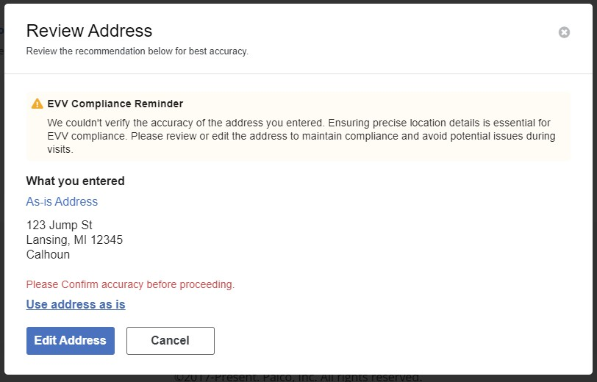
PARTICIPANT WORKSITE LOCATIONS
Step 6.
Review the Address for Accuracy
Double-check the spelling of each line. Make sure the house number and ZIP code are also correct.
Step 7.
Decide to Use As-Is or Edit Address
If the address is correct, you can choose to “Use address as-is.” If a correction is needed, choose Edit Address to make changes.

Slide 28

TIME ENTRY

Slide 29
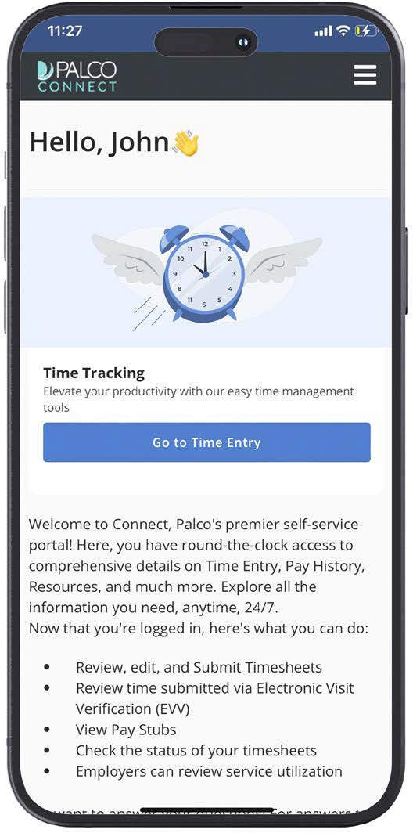
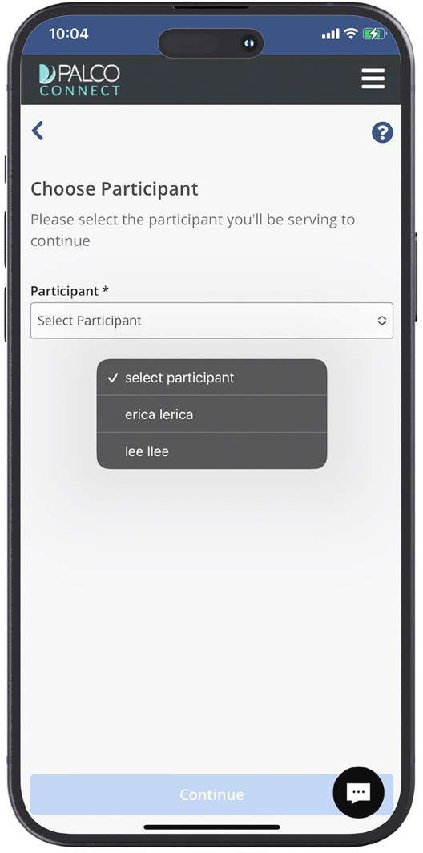
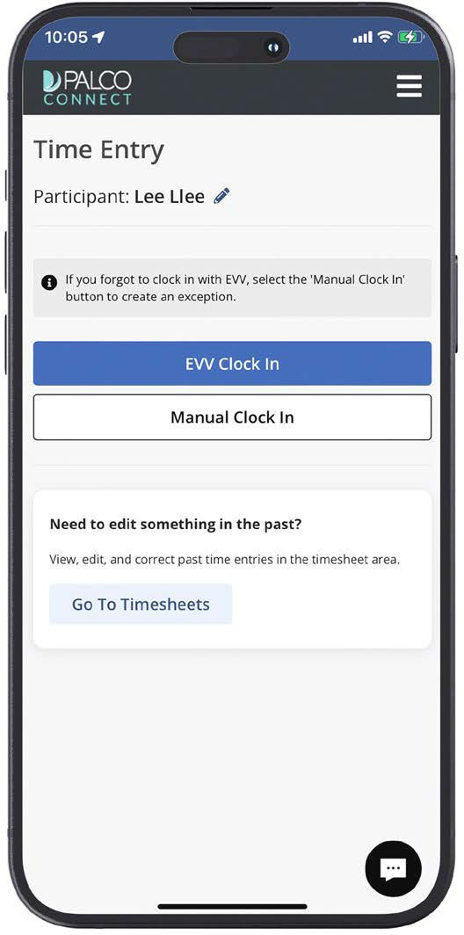
WORKER CLOCK IN
In this section, we will go over how to start an EVV-compliant time entry. Once logged into Connect, follow these steps.
Step 1. Click on Go to Time Entry Step 2. Select a Participant Step 3. Choose EVV Clock In
This blue button is on the home screen.
You will only need to select a Participant if you work for more than one.
29
Notes:
Step 3:
2 options – EVV clock in
Manual clock in – live in’s can

Slide 30
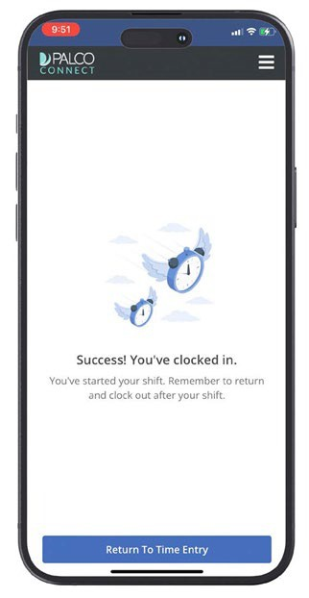

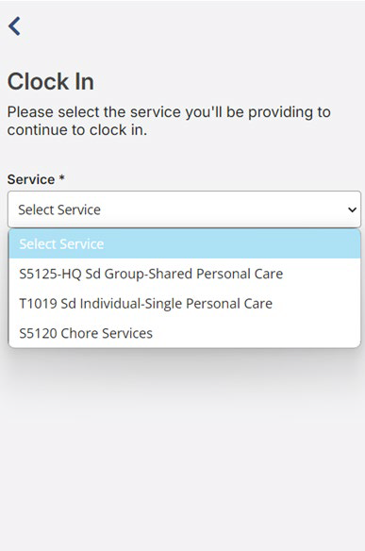
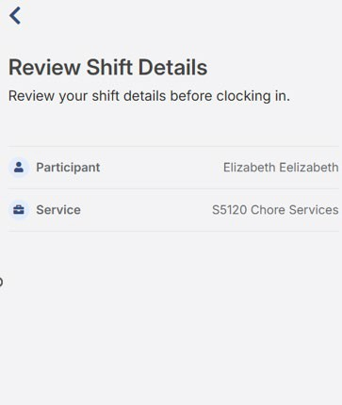
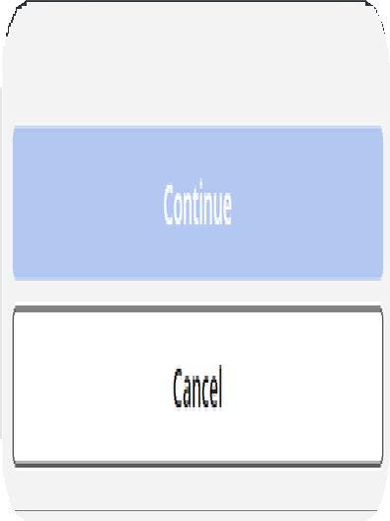
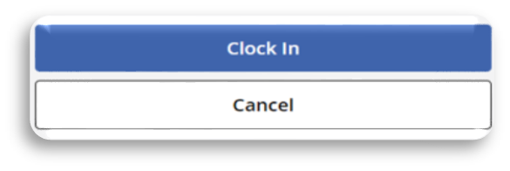
WORKER CLOCK IN
Step 4. Select a Service to Provide
Step 5. Review Shift Details
Step 6. Clock In for the Shift
Service code options will be in the drop-down menu.
Double-check that everything is right before submitting.
You are now on the clock for this shift.

Slide 31
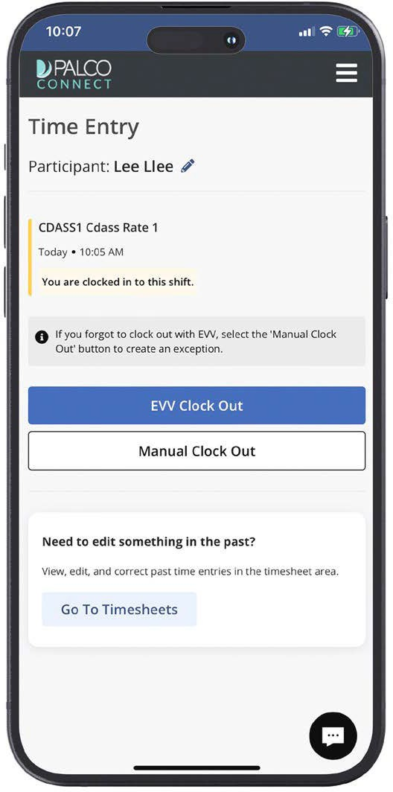
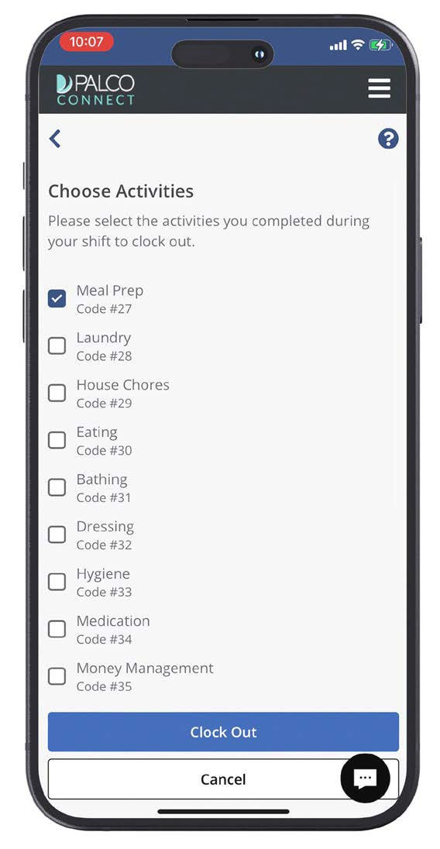
WORKER CLOCK OUT
The clock out process is very similar to clocking in. Please, do not clock out until you are finished working the shift.
Step 1. Click on Go to Time Entry Step 2. Choose EVV Clock Out Step 3. Select Activities
T1019 SE Individual SD PCA
This blue button is on the home screen.
You will see you are currently clocked in for this shift above the blue EVV clock out button.
Use the check boxes to select all activities that were performed during the shift.

Slide 32
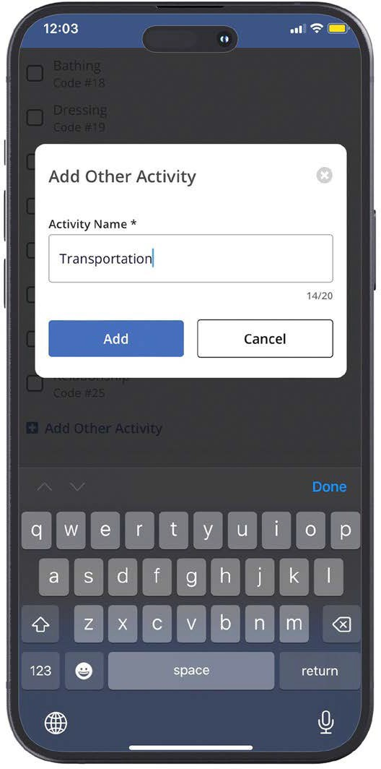
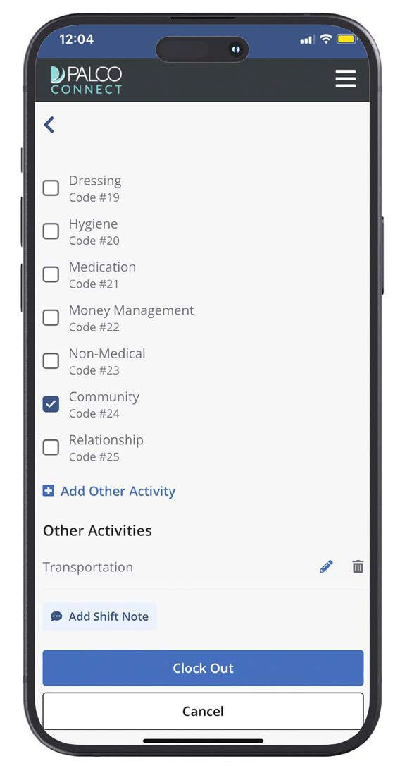
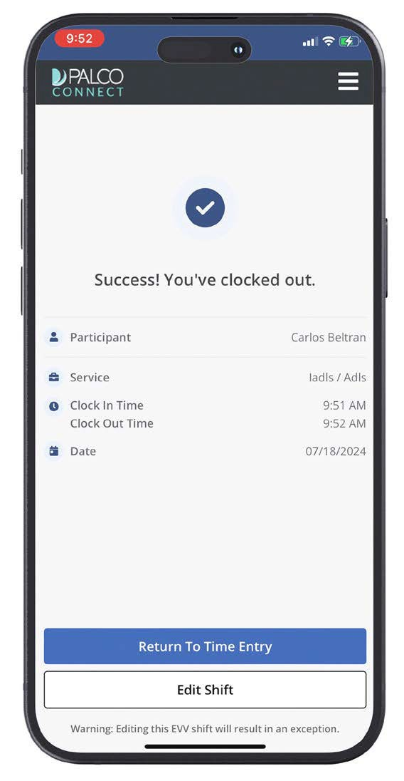
WORKER CLOCK OUT
Step 4. Add Manual Activities
Step 5. Review Shift Details and Clock Out
Step 6. Review Confirmation
If needed, you can manually
Double-check all details
A confirmation screen will show that
add an activity.
before tapping clock out.
you were successfully clocked out.
32

Slide 33
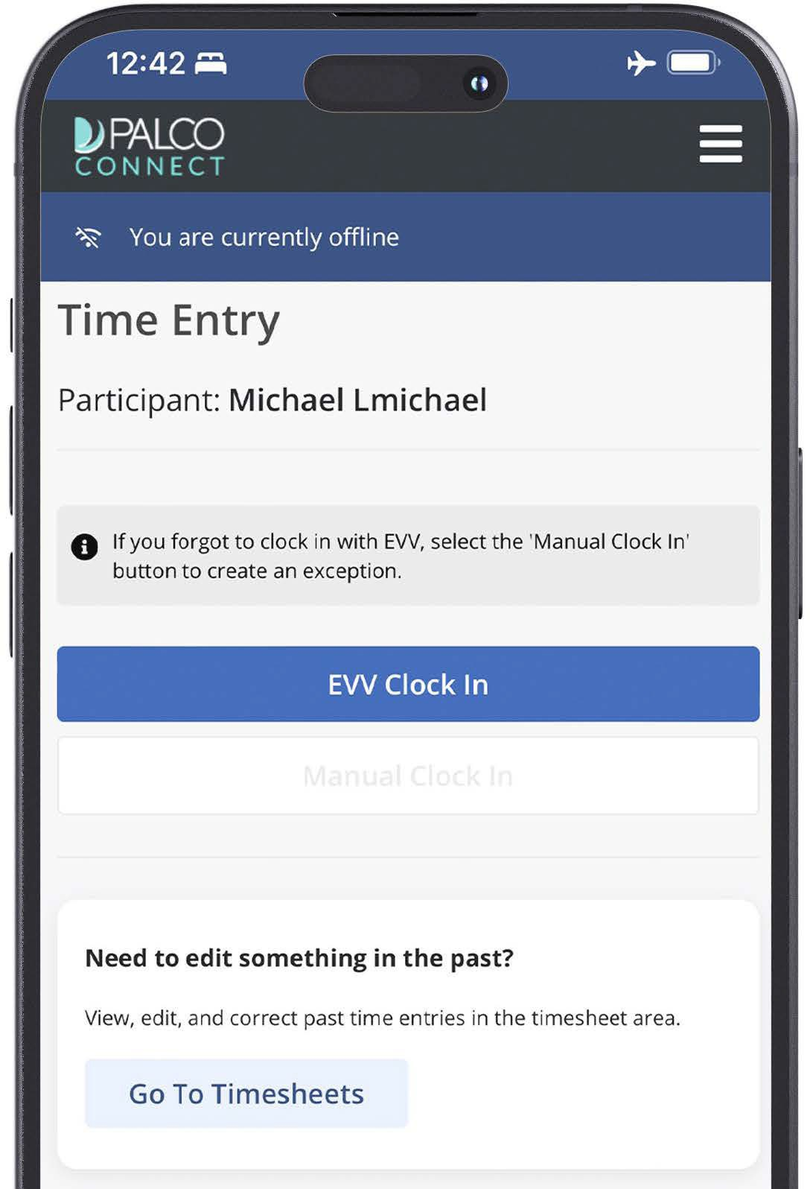
OFFLINE MODE
If you are without internet access, you can still clock in and out for shifts. You will follow all the same steps as before. The difference is that you will be in offline mode. Once your internet service is restored, your offline shift data will be synced automatically.
You will know you are offline when you see the blue banner near the top of the screen.
When offline, your menu options will be limited. For full use of the Palco EVV app, connect to the internet.
When offline, you will not be able to manually clock in. You can only record an EVV shift when you are offline.
33

Slide 34
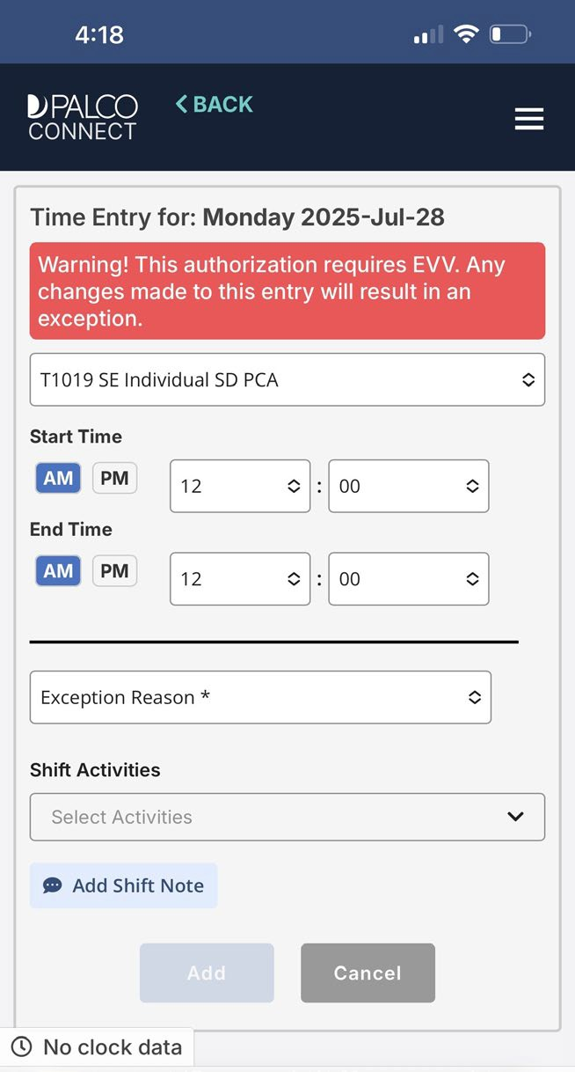
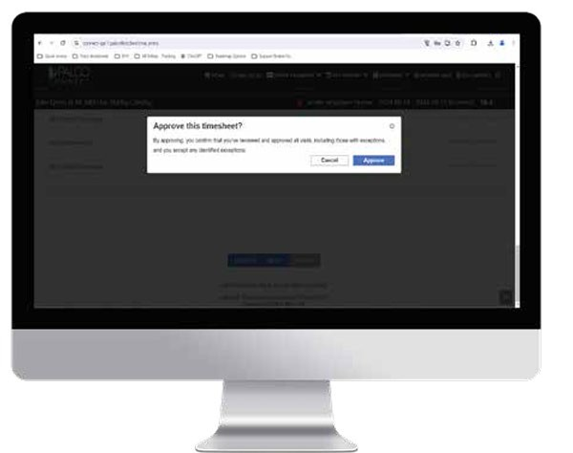
SHIFT EXCEPTIONS
KASIE WEST AT NJ_PPP FOR CARLOS
Shift exceptions occur when an EVV shift is edited after it has been completed.
WORKERS:
If you need to edit a shift, you will be asked for the exception reason. Please choose the reason that best explains why the entry is being edited.
PARTICIPANT/AUTHORIZED REPRESENTATIVE:
Please review all time shifts. If a shift has an exception, make sure it is correct. By approving a shift, you are stating that you agree with the date, time, and exception reason being reported by the worker.
Please Note:
Edits should be limited and will be monitored. EVV compliance is a requirement for the PPP Program.
34

Slide 35
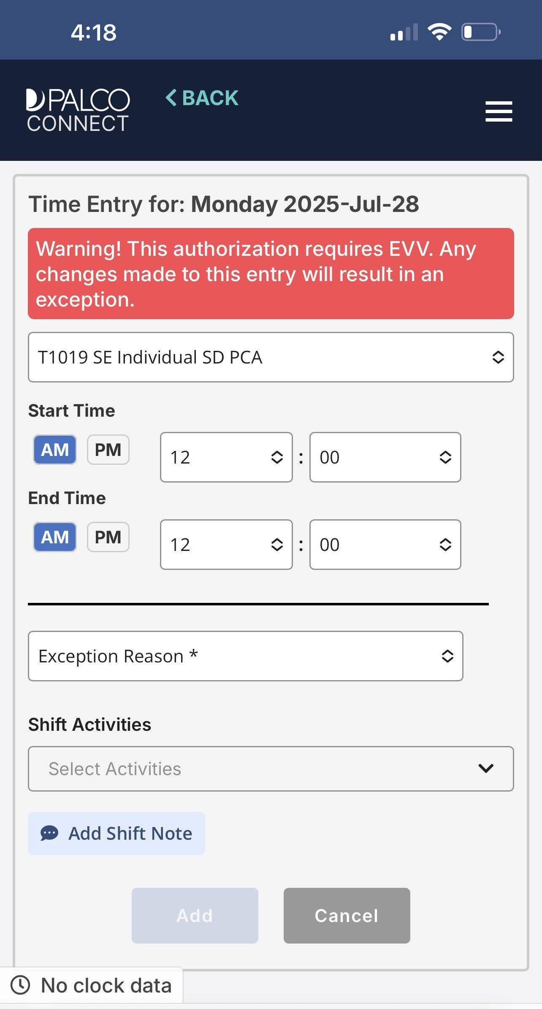


SHIFT EXCEPTIONS
I’m a worker. How do I avoid shift exceptions?
Clocking in and out promptly is the easiest way to avoid exceptions. It can also help to double-check all information before selecting Clock In or Clock Out. That way, you do not need to edit a shift later.
I’m the participant. Why do I need to verify the reason for a shift exception?
Part of your role is to manage your workers. The accuracy of your worker’s time shift reporting can affect your budget. It could also affect your program eligibility. It is very important that the hours submitted for payment are what was worked.
35

Slide 36

INTERACTIVE VOICE RESPONSE (IVR)

Slide 37





Interactive Voice Response, also known IVR, is another way to report EVV shifts. With IVR, a worker uses the participant’s touchtone phone to clock in and out. They do this by calling a designated number and responding to the prompts. It is also known as Telephony.
INTERACTIVE VOICE RESPONSE (IVR)
Step 1: To use Interactive Voice Response, call 888-788-8270 using a touchtone phone.
Step 2: Use the keypad to enter the worker’s Palco ID, then hit # (the pound key).
Step 3: Enter last 4 of worker’s SSN, then hit # (the pound key).
Step 4: Select the time zone.
Step 5: Enter the participant Palco ID, then hit # (the pound key).
37

Slide 38

INTERACTIVE VOICE RESPONSE (IVR) CLOCKING IN/OUT
Clocking in: You will be asked to select a service. Once done, you’ll need to confirm your selection.
Clocking out: Key in the appropriate activity code, then press # (the pound key) or skip.
You will be asked to confirm your selection.
38

Slide 39
TIMESHEET REVIEW &
SUBMISSON

Slide 40

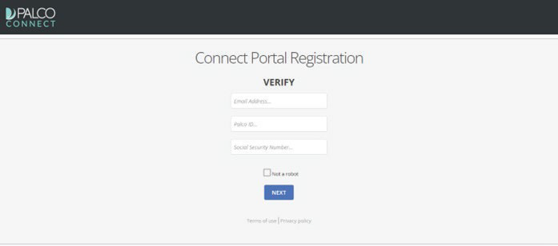
CONNECT
Connect is Palco’s online timesheet portal for Participants and Workers. Connect provides everything a self-directing
Participant or Worker may need, right at their fingertips!
Accessible 24/7, some features of Connect include the ability to enter time, integration with Electronic Visit Verification (EVV), the ability to track and monitor spending, to update personal
contact information, and access W-2s and paystubs.

Slide 41
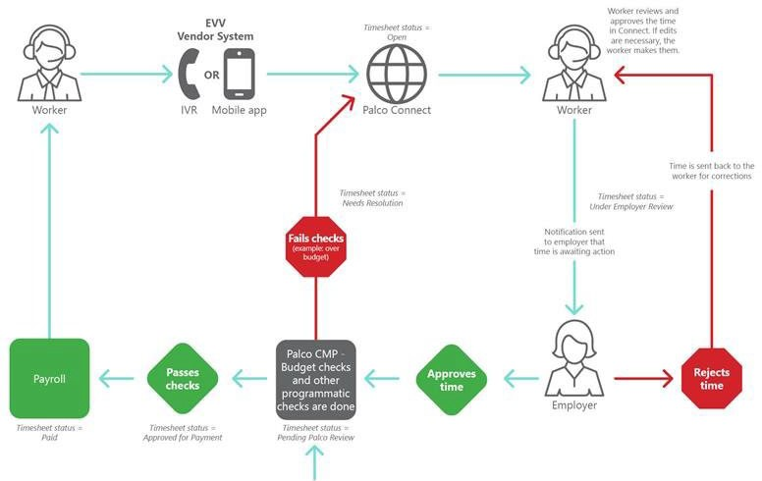

CONNECT
Here is how the process works:
Notification sent to employer and worker
PALCO

Slide 42
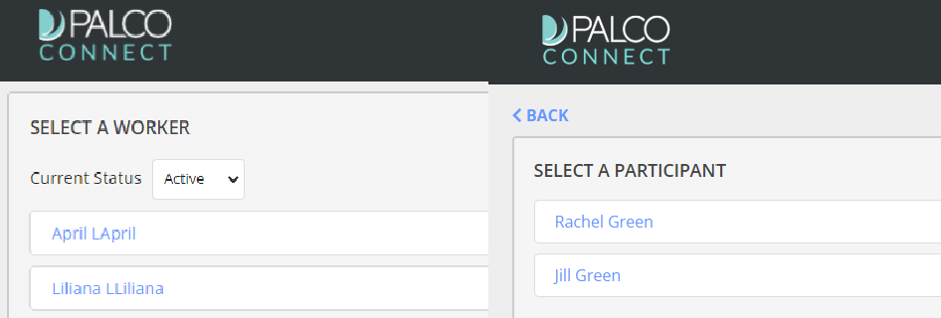
APPROVING TIME
Every timesheet requires two approvals - one by the worker and one by the participant/AR. The timesheet will be automatically created once EVV shifts are recorded for the pay period and in a status open for the worker to review and submit to their participant. When the timesheet is pending for participant/AR review, it will be locked for edits.
Login to the Connect portal, https://connect.palcofirst.com/, with your username and password.
At the top of the screen, select the “Time Entry” tab by clicking on it.
If you are the participant/AR and have more than one worker, or if you are the worker for more than one participant, select the worker or participant for whom services were provided.
42

Slide 43
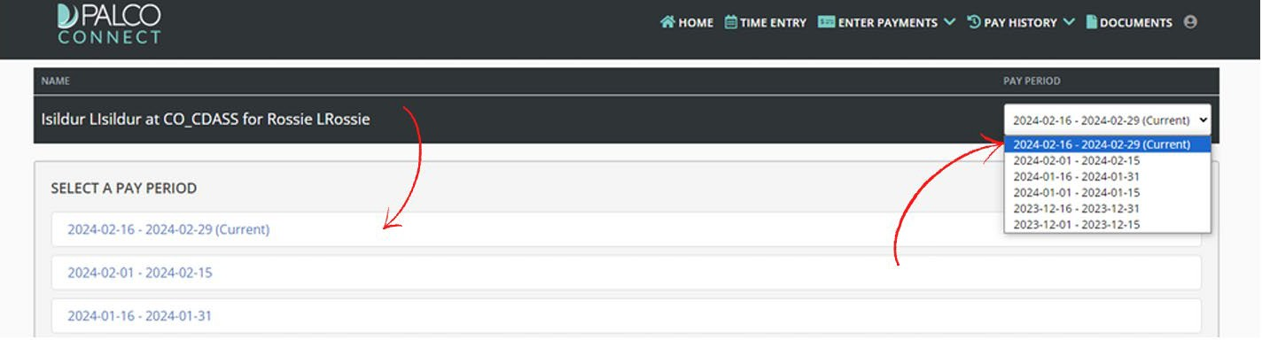
APPROVING TIME
4. Select the pay period from either the center of the page or the dropdown at the top right of the screen.
At NJ_PPP_HZN for Rachel Green

Slide 44
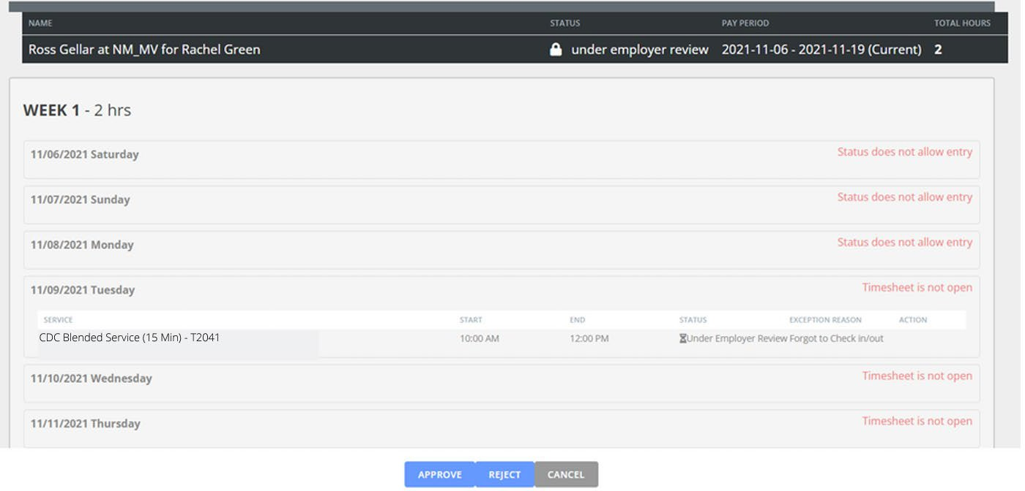
APPROVING TIME
5. Review the information and determine if the timesheet should be “approved” or “rejected” for corrections.
Approve:
Selecting "Approve" confirms that all shifts are accurate and complete. As the Participant / AR , you are responsible for reviewing the schedule. Once approved, the timesheet will be submitted to Palco for payment processing and validation.
At NJ_PPP_HZN for Rachel Green
T1019 Personal Care
Reject:
Selecting "Reject" sends the timesheet back to the worker for corrections. Only reject if it's incorrect and ensure timely updates to avoid missing payroll deadlines.

Slide 45

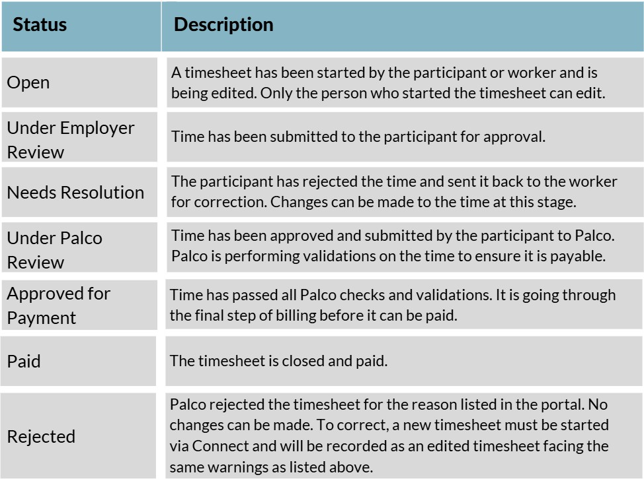
Timesheet Status
Notes:
Timesheet Statuses are available so you can quickly and conveniently see the payment processing stage of a timesheet. A participant / employer can see the status of all timesheets for their workers and workers can see the status of any timesheet they have submitted in the Connect application's "Timesheet Overview" screen.

Slide 46
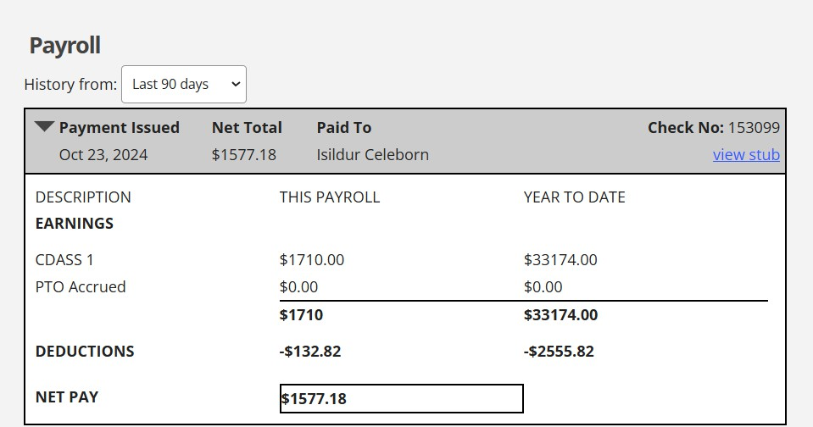
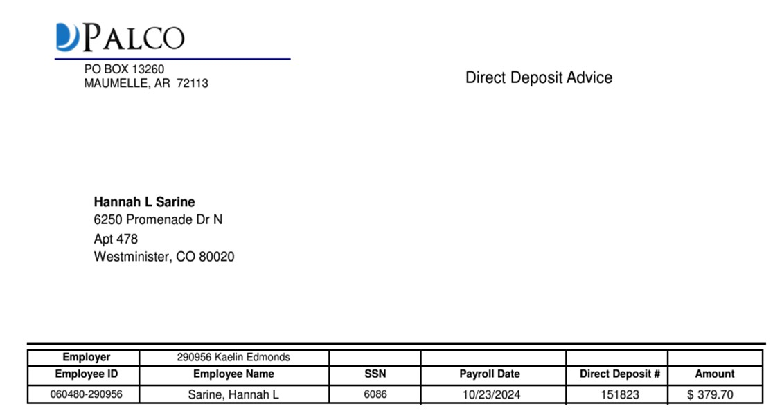

Payment Detail provides both the participant/AR and worker access to pay stub information and history.
CONNECT- PAY STUBS
Thumb, Tom
Ron Thumb
Ron Thumb
123 Lilliput Lane
Tallahassee, FL 32301
Thumb, Ron
46

Slide 47

Program Reminders

Slide 48

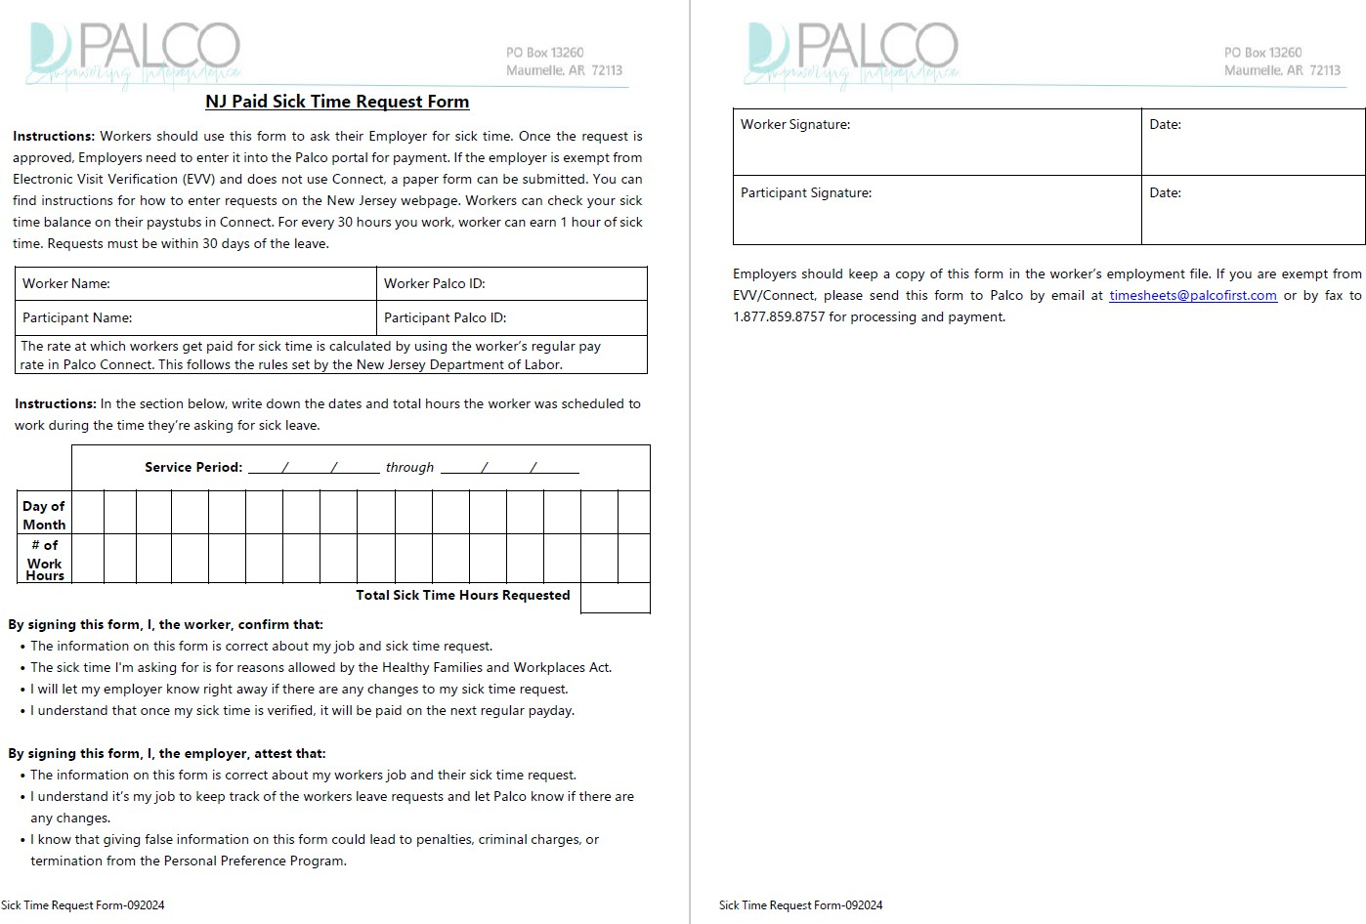
New Jersey Sick Time
 Sick Time must be submitted within 30 days
 Sick Time can be requested on “Sick Time Request Form”
OR
submitted via Connect.
 Sick Time can be rolled over from previous calendar year, up to 40 hours.
 Sick Time is submitted by the Participant.
Notes:
By signing this form, I, the worker, confirm that:
The information on this form is correct about my job and sick time request.
The sick time I'm asking for is for reasons allowed by the Healthy Families and Workplaces Act.
I will let my employer know right away if there are any changes to my sick time request.
I understand that once my sick time is verified, it will be paid on the next regular payday.
By signing this form, I, the employer, attest that:
The information on this form is correct about my attendant’s job and their sick time request.
I understand it’s my job to keep track of the attendant’s leave requests and let Palco know if there are any changes.

Slide 49
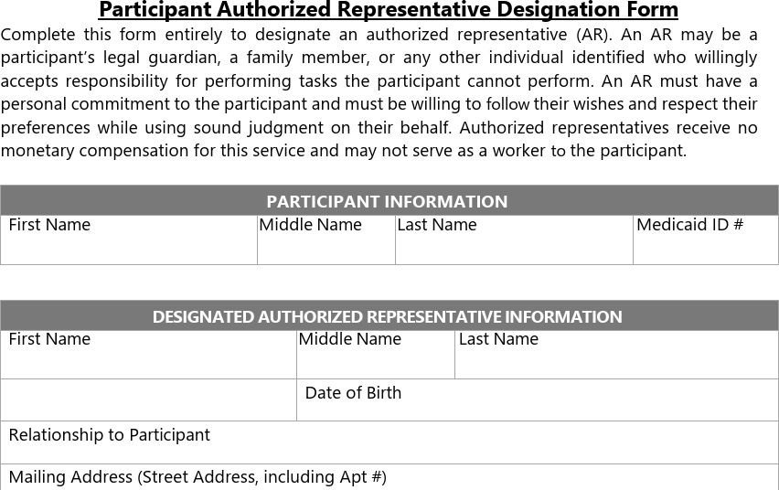
Designation of Surrogate Employer (Optional)
Types of Authorized Representative:
Voluntary- Participant may choose to appoint an AR for various reasons
Predetermined- Participant has a predetermined representative such as legal guardian or court appointed
Mandatory – Participant has misused the budget or is unable to manage the program. Minor children as well.
Notes:
As the designated authorized representative, I agree to:
Work with the Cash & Counseling consultant to provide information to develop the Cash Management Plan (CMP) on the participant’s behalf.
Help ensure that the cash grant is used for the items outlined in the Cash Management Plan, taking into account the participant’s wishes.
Maintain records, as required by the State, regarding planned expenditures. This includes ensuring that worker timesheets and non-labor invoices are completed, signed, and submitted to the Fiscal Management Service for processing.

Slide 50

CUSTOMER SUPPORT & RESOURCES

Slide 51

VF/EA PPP Handbook
 Employer Handbook
 Key Terms and Information
 Roles and Responsibilities
 Role of the VF/EA, FMS
 Role of the Employer
 Hiring a Worker
51

Slide 52




PALCARE
PalCare is Palco’s self-direction job board for connecting prospective Employers and Caregivers for long- term meaningful career relationships.
 Caregiver can create a profile to showcase skills and availability in hopes of gaining employment.
 Employer can post job description for positions they are seeking to fill.
 Totally free and is operational for all Palco’s self-direction programs!
To get started with PalCare, visit:
palcare.palcofirst.com
52
Notes:
Why is Palcare so important to the self direction industry?
• When a self-directed employer is seeking caregivers, there is often nowhere free for them to go and post an ad. Care.com and other services cost money, and Craigslist may be free, but responses are often not legitimate.
• Caregiving as a career can be difficult to achieve because working for a participant (usually a loved one) does not often equate to 40 hours of care. Often needing flexible hours to meet the needs of that participant, caregivers are often somewhat stuck working a less-than-full-time employment and experiencing poverty. By connecting caregivers with others in their community who may also need care that is less than full time, we bridge the gap, making it more obtainable for them to continue their necessary work as a caregiver.
• The more resources like this that Palco is able to put in place, the more self-directed programs become legitimized. It is important for the public to understand that these are real programs with real employers and real workers who deserve the same access and benefits as others.

Slide 53


RESOURCES
You can find many helpful resources, training documents, forms, and
videos on the Palco website!
https://palcofirst.com/new-jersey-ppp/

Slide 54
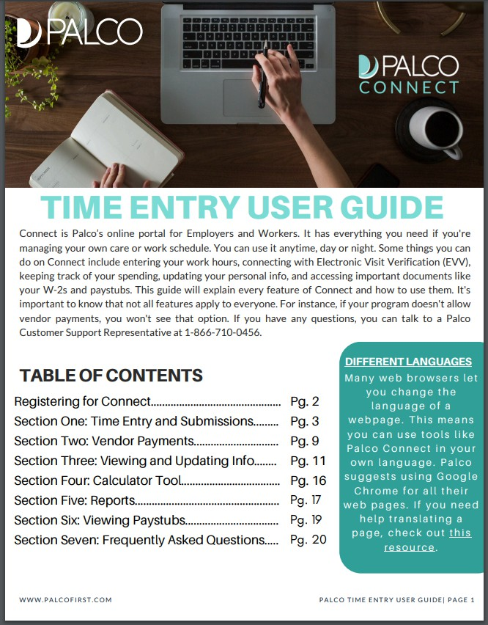
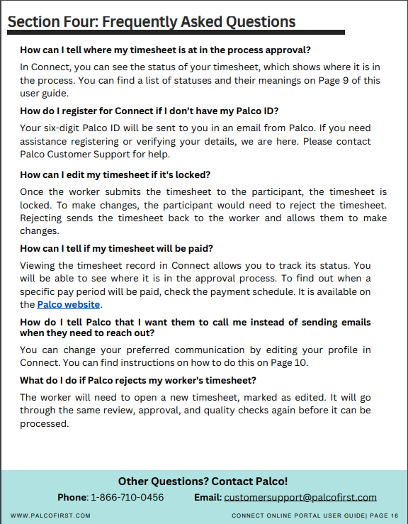
PALCO’S TIME ENTRY TRAINING RESOURCE
 Connect Registration
 Time Entry and Approval
 EVV
 Reports
 Viewing Paystubs
 FAQ
TIME ENTRY USER GUIDE

Slide 55
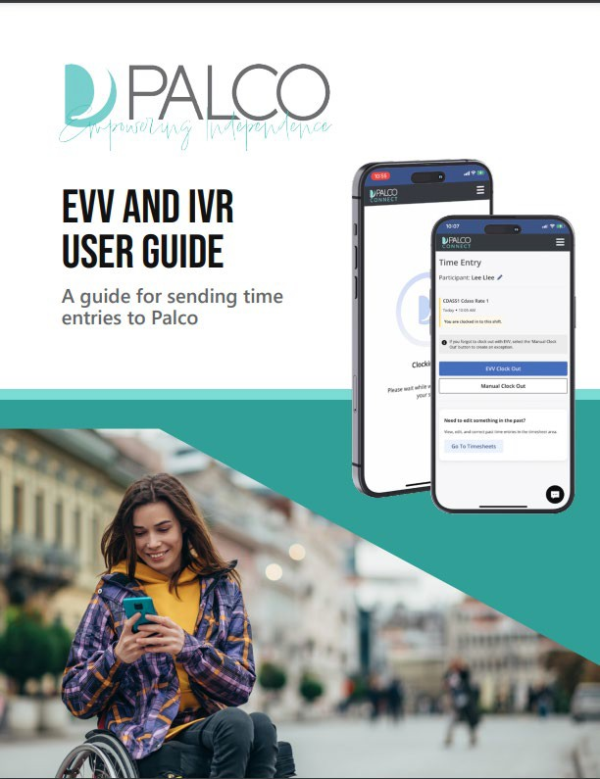
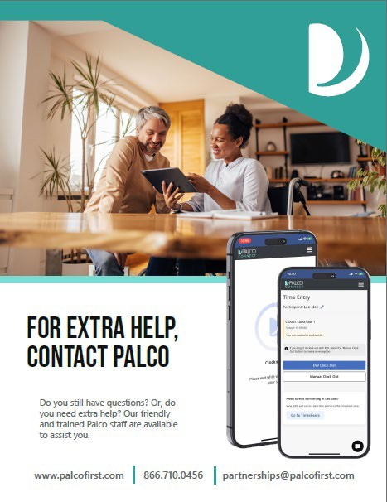
PALCO’S EVV
TRAINING RESOURCE
 Connect
 Telephony / IVR (Interactive Voice Recognition)

Slide 56


You can contact the Palco Customer Support team Monday-Friday between 8:00am and 5:00pm EST.
CUSTOMER SUPPORT
Phone: 1-877-710-0457
Local: 732-351-4804
Email: Support_NJ@palcofirst.com

Slide 57

QUESTIONS

Slide 58



Thank you for your time!

